Slide 1
RL algorithms analysis
Yue Wang
2017.3.16

Slide 2
Content
Basic notation
Evaluation problem
  Objective function
  Optimization techniques
  Extend to off-policy and eligibility trace
  Paper
  Control problem
    relationship and difference between control and evaluation problem
    paper

Slide 3
Content
Eligibility trace
Convergence rate analysis(finite sample analysis)
  Evaluation problem
  Control problem
Last week discussion problem
  Off policy and importance sampling

Slide 4
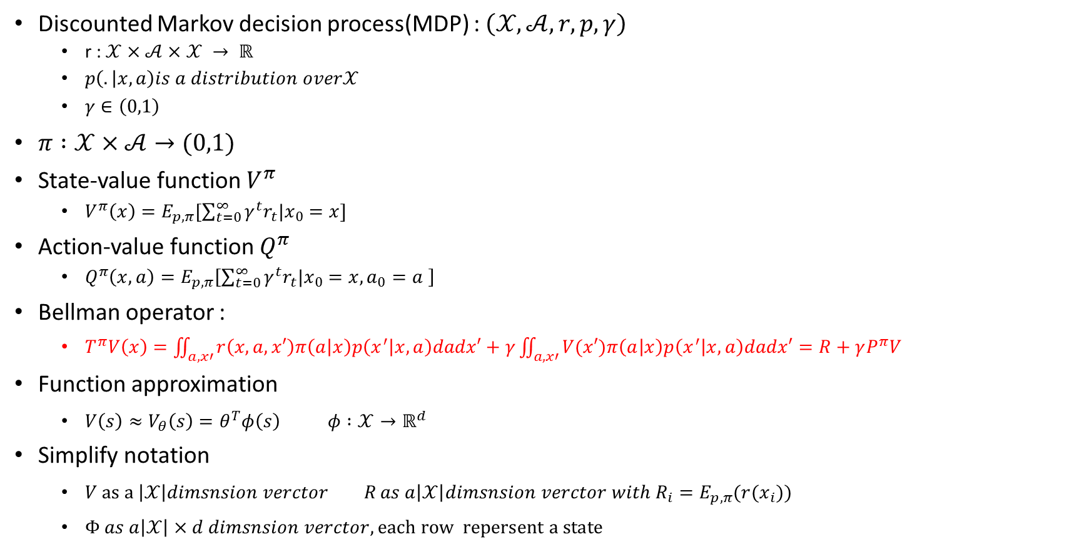
Basic notation
Discounted Markov decision process(MDP) : $\left(𝒳,𝒜,r,p,γ\right)$
  r : $𝒳×𝒜×𝒳 → ℝ$
  $p\left(. | x,a\right)is a distribution over𝒳$
  $γ∈\left(0,1\right)$
$π :𝒳×𝒜→(0,1)$
State-value function $V^{π}$
  $V^{π}\left(x\right)=E_{p,π}[\sum_{t=0}^{∞}{γ^{t}r_{t}|x_{0}=x}]$
Action-value function $Q^{π}$
  $Q^{π}\left(x,a\right)=E_{p,π}\left[\sum_{t=0}^{∞}{γ^{t}r_{t}|x_{0}=x,a_{0}=a }\right]$
Bellman operator :
  $T^{π}V\left(x\right)=\iint_{a,x′}{r\left(x,a,x′\right)π\left(a | x\right)p\left(x^{′} | x,a\right)dadx′}+γ\iint_{a,x′}{V(x′)π\left(a | x\right)p\left(x^{′} | x,a\right)dadx′}=R+γP^{π}V$
  Function approximation
    $V\left(s\right)≈V_{θ}\left(s\right)=θ^{T}φ\left(s\right) φ :𝒳→ℝ^{d}$
  Simplify notation
    $V as a \left|𝒳\right|dimsnsion verctor R as a\left|𝒳\right|dimsnsion verctor with R_{i}=E_{p,π}(r(x_{i}))$
    $Φ as a\left|𝒳\right|×d dimsnsion verctor, each row repersent a state$

Slide 5
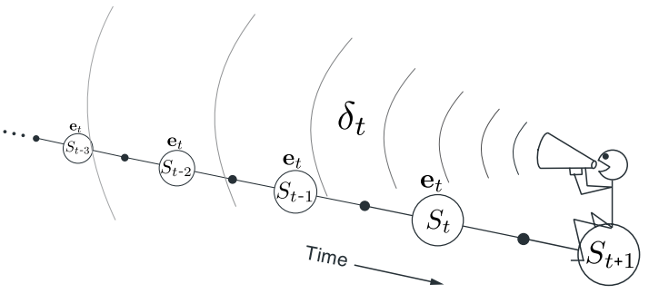
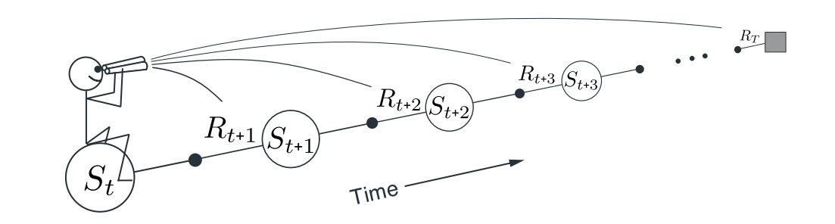
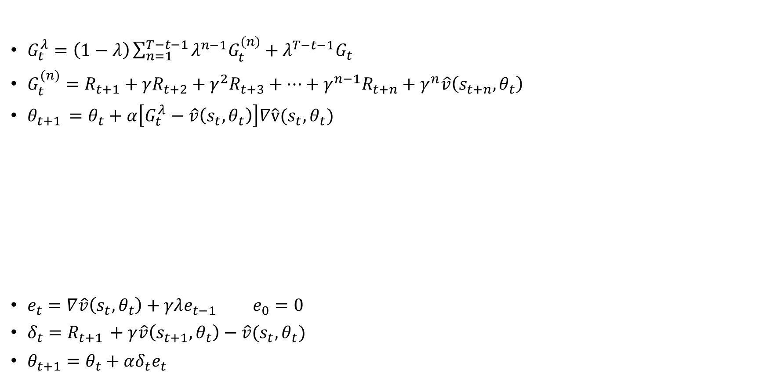
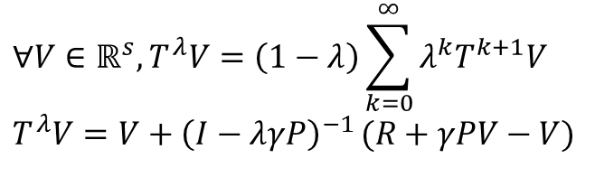
eligibility traces
$$∀V∈ℝ^{s},T^{λ}V=\left(1−λ\right)\sum_{k=0}^{∞}{λ^{k}T^{k+1}V}$$
$$T^{λ}V=V+{\left(I−λγP\right)}^{−1 }(R+γPV−V)$$
$G_{t}^{λ}=\left(1−λ\right)\sum_{n=1}^{T−t−1}{λ^{n−1}G_{t}^{(n)}}+λ^{T−t−1}G_{t}$
$G_{t}^{(n)}=R_{t+1}+γR_{t+2}+γ^{2}R_{t+3}+…+γ^{n−1}R_{t+n}+γ^{n}\hat{v}\left(s_{t+n},θ_{t}\right)$
$θ_{t+1 }=θ_{t}+α\left[G_{t}^{λ}−\hat{v}\left(s_{t},θ_{t}\right)\right]∇\hat{v}(s_{t},θ_{t})$
$e_{t}=∇\hat{v}\left(s_{t},θ_{t}\right)+γλe_{t−1} e_{0}=0$
$δ_{t}=R_{t+1 }+γ\hat{v}\left(s_{t+1},θ_{t}\right)−\hat{v}(s_{t},θ_{t})$
$θ_{t+1}=θ_{t}+αδ_{t}e_{t}$

Slide 6
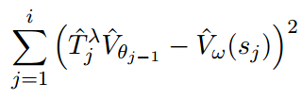
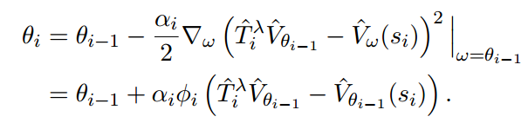

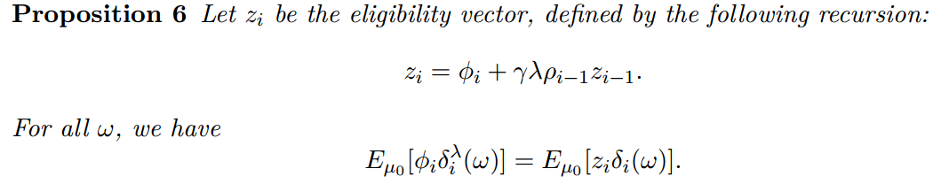

Off policy with eligibility traces(TD($λ$))
Geist, Matthieu, and Bruno Scherrer. "Off-policy learning with eligibility traces: a survey." Journal of Machine Learning Research 15.1 (2014): 289-333.

Slide 7
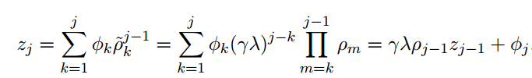
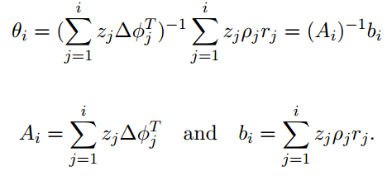

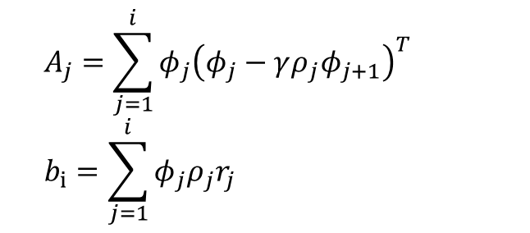

Off policy with eligibility traces(LSTD($λ$))
Without eligibility trace
With eligibility trace
    $$A_{j}=\sum_{j=1}^{i}{φ_{j}{\left(φ_{j}−γρ_{j}φ_{j+1}\right)}^{T}}$$
    $$b_{i}=\sum_{j=1}^{i}{φ_{j}ρ_{j}r_{j}}$$

Slide 8
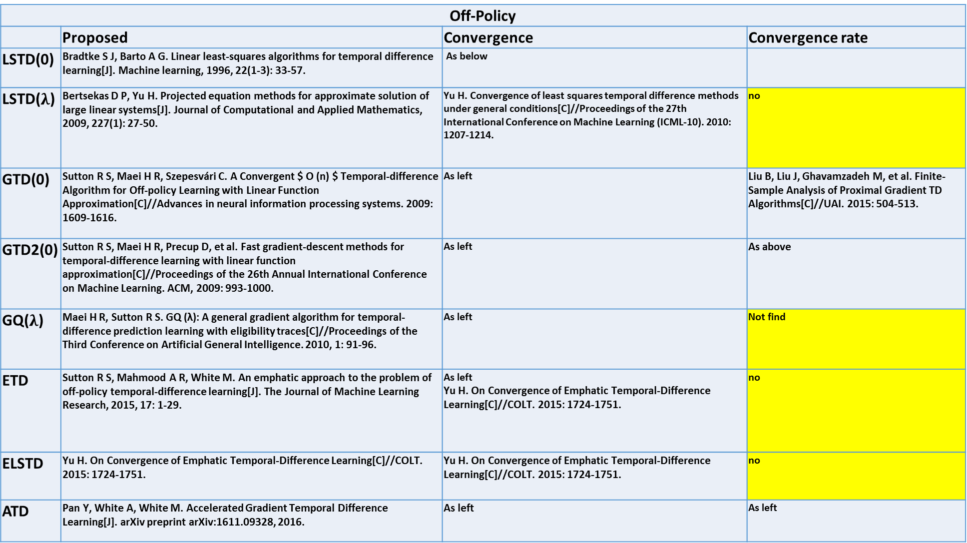
Off-Policy
 | Proposed | Convergence | Convergence rate
LSTD(0) | Bradtke S J, Barto A G. Linear least-squares algorithms for temporal difference learning[J]. Machine learning, 1996, 22(1-3): 33-57. | As below
LSTD($λ$) | Bertsekas D P, Yu H. Projected equation methods for approximate solution of large linear systems[J]. Journal of Computational and Applied Mathematics, 2009, 227(1): 27-50. | Yu H. Convergence of least squares temporal difference methods under general conditions[C]//Proceedings of the 27th International Conference on Machine Learning (ICML-10). 2010: 1207-1214. | no
GTD(0) | Sutton R S, Maei H R, Szepesvári C. A Convergent $ O (n) $ Temporal-difference Algorithm for Off-policy Learning with Linear Function Approximation[C]//Advances in neural information processing systems. 2009: 1609-1616. | As left | Liu B, Liu J, Ghavamzadeh M, et al. Finite-Sample Analysis of Proximal Gradient TD Algorithms[C]//UAI. 2015: 504-513.
GTD2(0) | Sutton R S, Maei H R, Precup D, et al. Fast gradient-descent methods for temporal-difference learning with linear function approximation[C]//Proceedings of the 26th Annual International Conference on Machine Learning. ACM, 2009: 993-1000. | As left | As above
GQ($λ$) | Maei H R, Sutton R S. GQ (λ): A general gradient algorithm for temporal-difference prediction learning with eligibility traces[C]//Proceedings of the Third Conference on Artificial General Intelligence. 2010, 1: 91-96. | As left | Not find
ETD | Sutton R S, Mahmood A R, White M. An emphatic approach to the problem of off-policy temporal-difference learning[J]. The Journal of Machine Learning Research, 2015, 17: 1-29. | As left Yu H. On Convergence of Emphatic Temporal-Difference Learning[C]//COLT. 2015: 1724-1751. | no
ELSTD | Yu H. On Convergence of Emphatic Temporal-Difference Learning[C]//COLT. 2015: 1724-1751. | Yu H. On Convergence of Emphatic Temporal-Difference Learning[C]//COLT. 2015: 1724-1751. | no
ATD | Pan Y, White A, White M. Accelerated Gradient Temporal Difference Learning[J]. arXiv preprint arXiv:1611.09328, 2016. | As left | As left

Slide 9
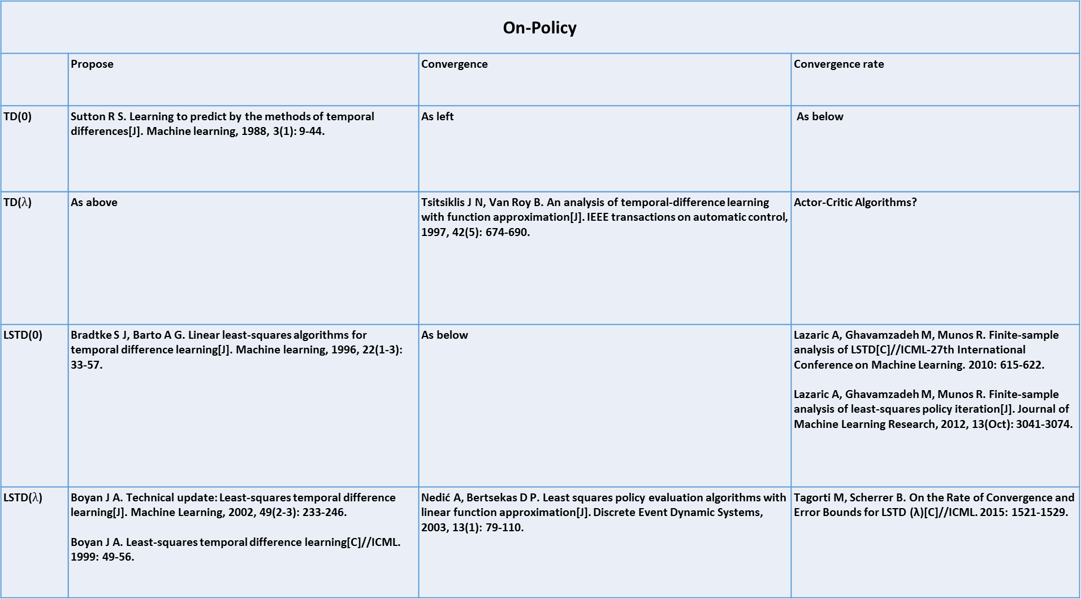
On-Policy
 | Propose | Convergence | Convergence rate
TD(0) | Sutton R S. Learning to predict by the methods of temporal differences[J]. Machine learning, 1988, 3(1): 9-44. | As left | As below
TD($λ$) | As above | Tsitsiklis J N, Van Roy B. An analysis of temporal-difference learning with function approximation[J]. IEEE transactions on automatic control, 1997, 42(5): 674-690. | Actor-Critic Algorithms?
LSTD(0) | Bradtke S J, Barto A G. Linear least-squares algorithms for temporal difference learning[J]. Machine learning, 1996, 22(1-3): 33-57. | As below | Lazaric A, Ghavamzadeh M, Munos R. Finite-sample analysis of LSTD[C]//ICML-27th International Conference on Machine Learning. 2010: 615-622. Lazaric A, Ghavamzadeh M, Munos R. Finite-sample analysis of least-squares policy iteration[J]. Journal of Machine Learning Research, 2012, 13(Oct): 3041-3074.
LSTD($λ$) | Boyan J A. Technical update: Least-squares temporal difference learning[J]. Machine Learning, 2002, 49(2-3): 233-246. Boyan J A. Least-squares temporal difference learning[C]//ICML. 1999: 49-56. | Nedić A, Bertsekas D P. Least squares policy evaluation algorithms with linear function approximation[J]. Discrete Event Dynamic Systems, 2003, 13(1): 79-110. | Tagorti M, Scherrer B. On the Rate of Convergence and Error Bounds for LSTD (λ)[C]//ICML. 2015: 1521-1529.

Slide 10
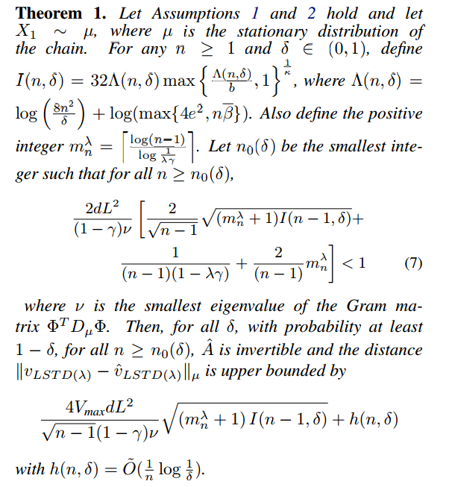

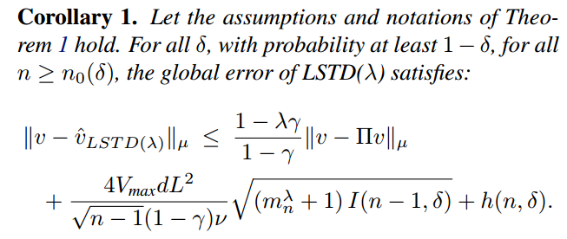


On the rate of convergence and error bounds for LSTD($λ$)
2015 ICML
On-policy, policy evolution, LSTD($λ$)
Theorem :
approximation error :
Estimation error :

Slide 11

On the rate of convergence and error bounds for LSTD($λ$)
2015 ICML
On-policy, policy evolution, LSTD($λ$)
Future work:
  Extend to policy iteration scheme
  LSTD($λ$) for off-policy(convergence has been proved by Yu 2010)

Slide 12


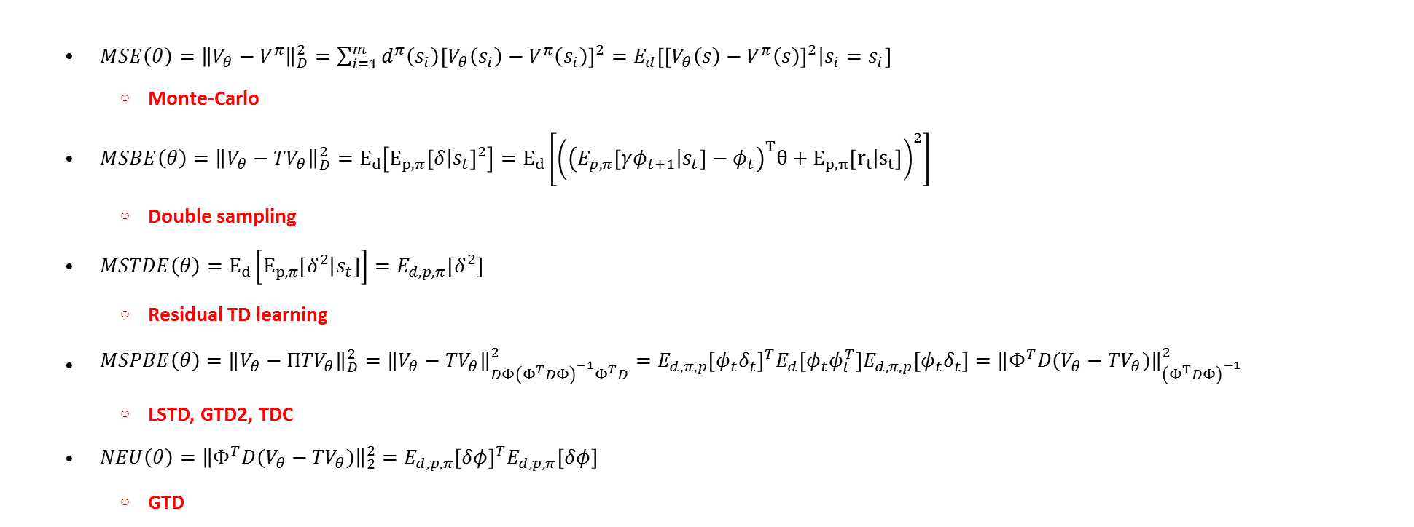
Objective function
  $MSE\left(θ\right)={\left\|V_{θ}−V^{π}\right\|}_{D}^{2}=\sum_{i=1}^{m}{d^{π}\left(s_{i}\right){\left[V_{θ}\left(s_{i}\right)−V^{π}\left(s_{i}\right)\right]}^{2}=E_{d}\left[{\left[V_{θ}\left(s\right)−V^{π}\left(s\right)\right]}^{2} | s_{i}=s_{i}\right]}$
    Monte-Carlo
  $MSBE\left(θ\right)={\left\|V_{θ}−{TV}_{θ}\right\|}_{D}^{2}=E_{d}\left[E_{p,π}{\left[δ | s_{t}\right]}^{2}\right]=E_{d}\left[{\left({\left(E_{p,π}\left[γφ_{t+1} | s_{t}\right]−φ_{t}\right)}^{T}θ+E_{p,π}\left[r_{t} | s_{t}\right]\right)}^{2}\right]$
    Double sampling
  $MSTDE\left(θ\right)=E_{d}\left[E_{p,π}\left[δ^{2} | s_{t}\right]\right]=E_{d,p,π}\left[δ^{2}\right]$
    Residual TD learning
  $MSPBE\left(θ\right)={\left\|V_{θ}−{ΠTV}_{θ}\right\|}_{D}^{2}={\left\|V_{θ}−{TV}_{θ}\right\|}_{DΦ{\left(Φ^{T}DΦ\right)}^{−1}Φ^{T}D}^{2}=E_{d,π,p}{\left[φ_{t}δ_{t}\right]}^{T}E_{d}\left[φ_{t}φ_{t}^{T}\right]E_{d,π,p}\left[φ_{t}δ_{t}\right]={\left\|Φ^{T}D(V_{θ}−{TV}_{θ})\right\|}_{{\left(Φ^{T}DΦ\right)}^{−1}}^{2}$
    LSTD, GTD2, TDC
  $NEU\left(θ\right)={\left\|{Φ^{T}D(V}_{θ}−{TV}_{θ})\right\|}_{2}^{2}=E_{d,p,π}{\left[δφ\right]}^{T}E_{d,p,π}\left[δφ\right]$
    GTD
GTD
GTD2

Slide 13
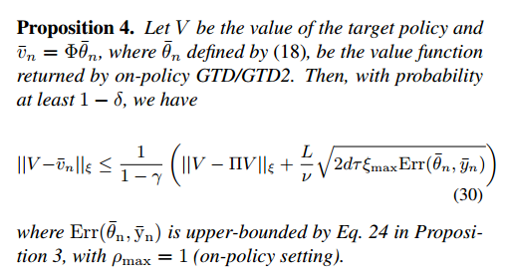

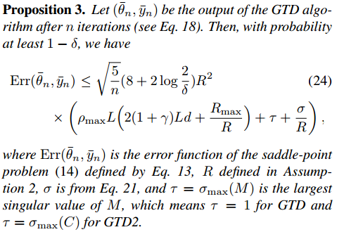
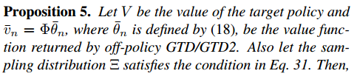
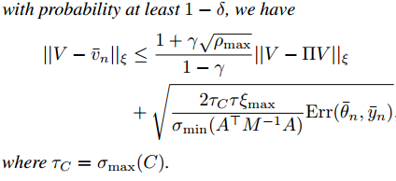
Finite-Sample Analysis of Proximal Gradient TD Algorithms
2015 UAL
On/Off-policy, policy evolution, GTD

Slide 14


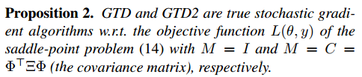
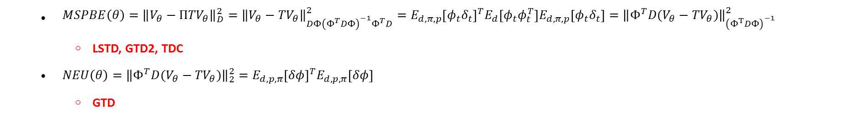
Finite-Sample Analysis of Proximal Gradient TD Algorithms
  $MSPBE\left(θ\right)={\left\|V_{θ}−{ΠTV}_{θ}\right\|}_{D}^{2}={\left\|V_{θ}−{TV}_{θ}\right\|}_{DΦ{\left(Φ^{T}DΦ\right)}^{−1}Φ^{T}D}^{2}=E_{d,π,p}{\left[φ_{t}δ_{t}\right]}^{T}E_{d}\left[φ_{t}φ_{t}^{T}\right]E_{d,π,p}\left[φ_{t}δ_{t}\right]={\left\|Φ^{T}D(V_{θ}−{TV}_{θ})\right\|}_{{\left(Φ^{T}DΦ\right)}^{−1}}^{2}$
    LSTD, GTD2, TDC
  $NEU\left(θ\right)={\left\|{Φ^{T}D(V}_{θ}−{TV}_{θ})\right\|}_{2}^{2}=E_{d,p,π}{\left[δφ\right]}^{T}E_{d,p,π}\left[δφ\right]$
    GTD
$J\left(θ\right)={\left\|Φ^{T}D\left(V_{θ}−TV_{θ}\right)\right\|}_{M^{−1}}^{2}={\left\|E[ρ_{t}δ_{t}φ_{t}]\right\|}_{M^{−1}}^{2} M=I for GTD M=Φ^{T}DΦ for GTD2$

Slide 15
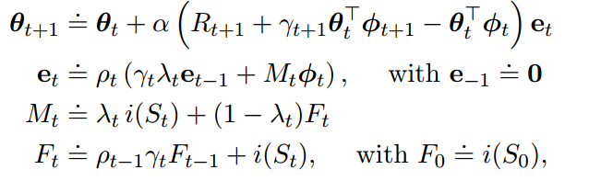
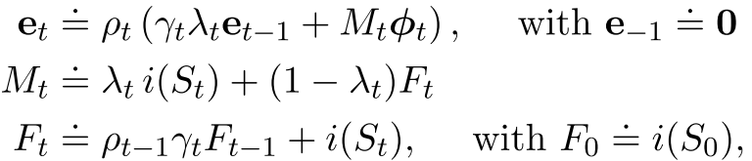
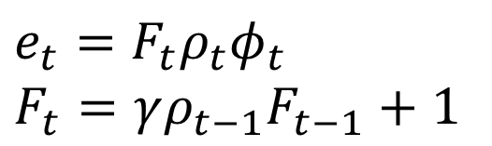
An emphatic approach to the problem of off-policy temporal-difference learning
2016 JMLR
Off-policy, policy evolution,
Future work:
  Extend to control setting
  Extend to weighted importance sampling
  Extend to action-value function
$$e_{t}=F_{t}ρ_{t}φ_{t}$$
$$F_{t}=γρ_{t−1}F_{t−1}+1$$

Slide 16
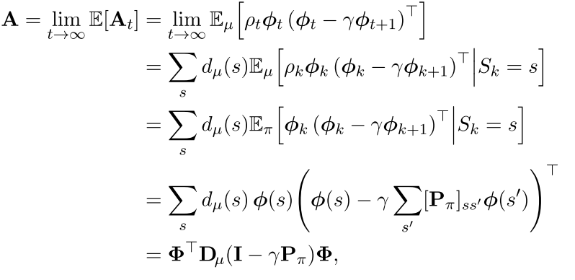


(review) Off-policy TD learning
OPE-FPE
  $θ={argmin}_{θ^{′}}OPE\left(θ^{′},w\right)={argmin}_{θ^{′}}\left\|V_{θ^{′}}−{TV}_{w}\right\|$
  $w=argmin_{w^{′}}FPE\left(θ,w′\right)={argmin}_{w′}\left\|V_{θ}−V_{w′}\right\|$
$θ_{t+1 }=θ_{t}+α_{t}ρ_{t}δ_{t}{φ(s}_{t})=θ_{t}+α_{t}(\underset{b_{t}}{\underbrace{ρ_{t}R_{t}φ_{t}}}− \underset{A_{t}}{\underbrace{ρ_{t}φ_{t}{\left(φ_{t}−γφ_{t+1}\right)}^{T}}}θ_{t})$
$ρ_{t}=\frac{π_{G\left(a_{t} | s_{t}\right)}}{π_{B\left(a_{t} | s_{t}\right)}}$
                ·
Stochastic algorithm is stable
Corresponding deterministic algorithms converge
A matrix has a full set of eigenvalues and real parts are positive
stochastic algorithm is stable + learning rate$α$is reduce according to an appropriate schedule
Convergence almost sure
Schoknecht, Ralf. "Optimality of reinforcement learning algorithms with linear function approximation." NIPS. Vol. 15. 2002.

Slide 17
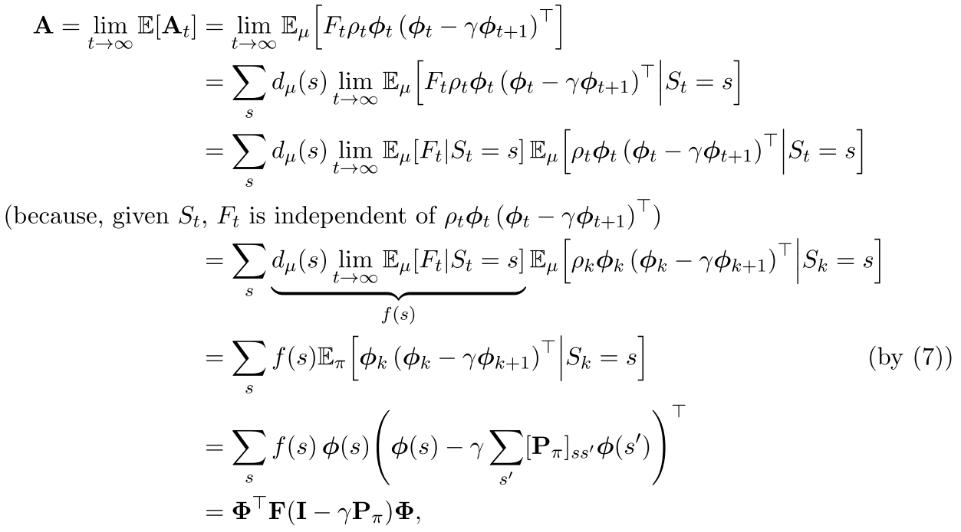

Off-policy Emphatic TD learning
$θ_{t+1 }=θ_{t}+α_{t}F_{t}ρ_{t}δ_{t}{φ(s}_{t})=θ_{t}+α_{t}(\underset{b_{t}}{\underbrace{F_{t}ρ_{t}R_{t}φ_{t}}}− \underset{A_{t}}{\underbrace{F_{t}ρ_{t}φ_{t}{\left(φ_{t}−γφ_{t+1}\right)}^{T}}}θ_{t})$
$ρ_{t}=\frac{π_{G\left(a_{t} | s_{t}\right)}}{π_{B\left(a_{t} | s_{t}\right)}}$ $F_{t}=γρ_{t−1}F_{t−1}+1$
                ·

Slide 18
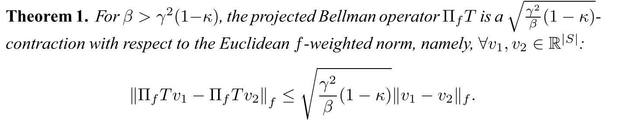
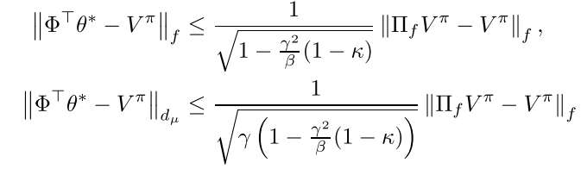

Generalized Emphatic Temporal Difference Learning: Bias-Variance Analysis
2016 AAAI
Off-policy, policy evolution, ETD
ETD$\left(0,β\right)$: $θ_{t+1}=θ_{t}+αF_{t}ρ_{t}\left(r_{t+1}+γθ_{t}^{T}φ_{t+1}−θ_{t}^{T}φ_{t}\right)φ_{t}$
$F_{t}=βρ_{t−1}F_{t−1}+1$
Define : $f=d_{μ}+βP_{π}^{T}d_{μ}+{\left(βP_{π}^{T}\right)}^{2}d_{μ}+…={\left(I−βP_{π}^{T}\right)}^{−1}d_{μ}$ $κ=\min_{s}\frac{d_{μ}(s)}{f(s)} ∈\left[0,1−β\right]$
$⁡$
Bias analysis:

Slide 19
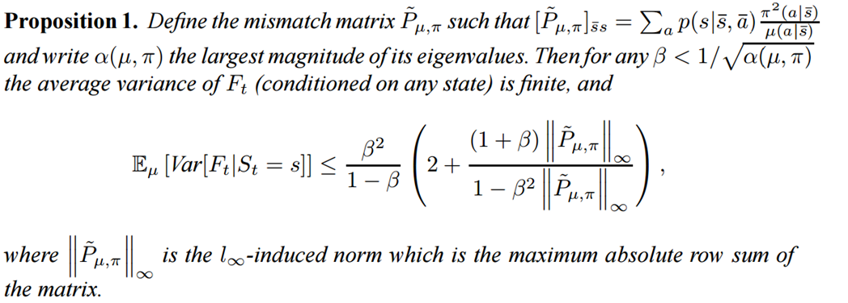

Generalized Emphatic Temporal Difference Learning: Bias-Variance Analysis
2016 AAAI
Off-policy, policy evolution, ETD
ETD$\left(0,β\right)$: $θ_{t+1}=θ_{t}+αF_{t}ρ_{t}\left(r_{t+1}+γθ_{t}^{T}φ_{t+1}−θ_{t}^{T}φ_{t}\right)φ_{t}$
$F_{t}=βρ_{t−1}F_{t−1}+1$
Define : $f=d_{μ}+βP_{π}^{T}d_{μ}+{\left(βP_{π}^{T}\right)}^{2}d_{μ}+…={\left(I−βP_{π}^{T}\right)}^{−1}d_{μ}$ $κ=\min_{s}\frac{d_{μ}(s)}{f(s)} ∈\left[0,1−β\right]$
Variance analysis :

Slide 20
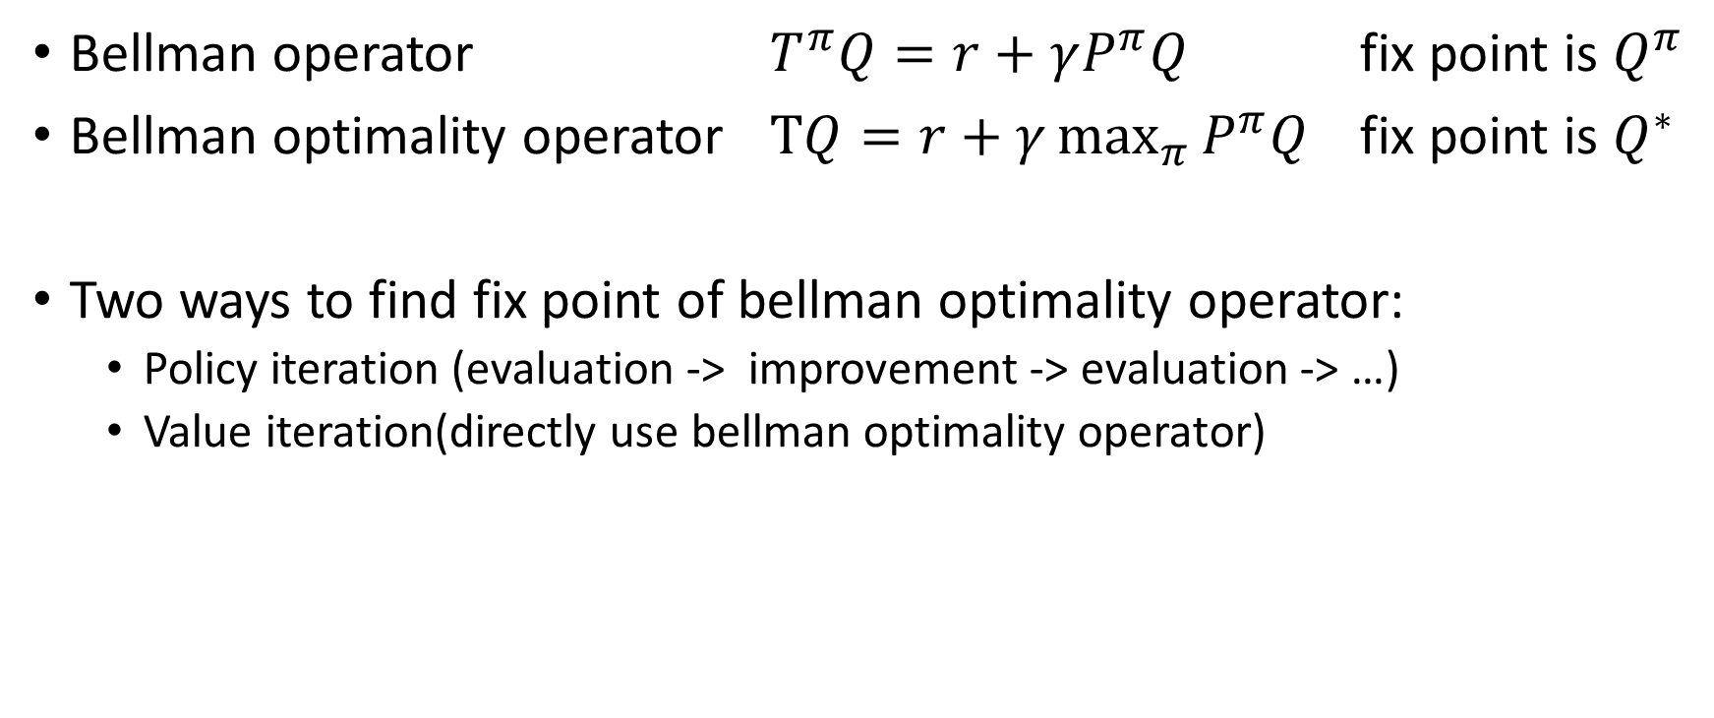
Control problem
Bellman operator $T^{π}Q=r+γP^{π}Q$ fix point is $Q^{π}$
Bellman optimality operator $TQ=r+γ\max_{π}{P^{π}Q}$ fix point is $Q^{∗}$
Two ways to find fix point of bellman optimality operator:
  Policy iteration (evaluation -> improvement -> evaluation -> …)
  Value iteration(directly use bellman optimality operator)

Slide 21
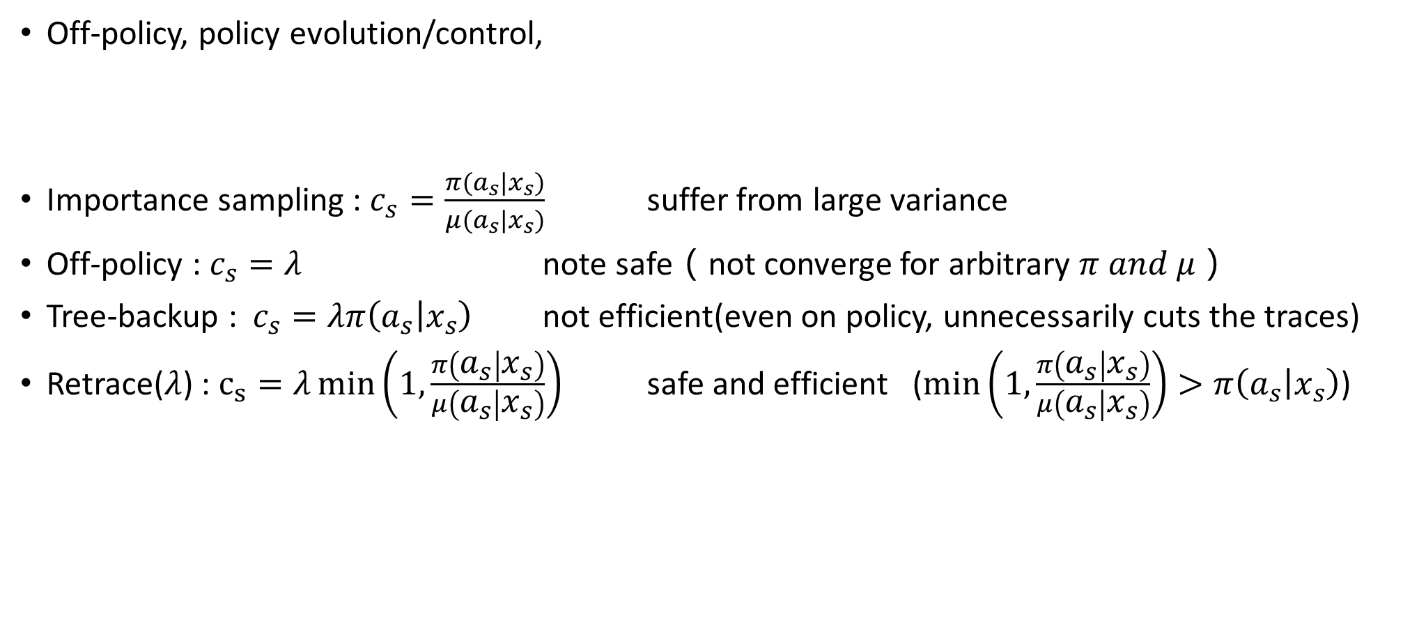
Safe and efficient off-policy reinforcement learning
2016 NIPS
Off-policy, policy evolution/control,
Importance sampling : $c_{s}=\frac{π(a_{s}|x_{s})}{μ(a_{s}|x_{s})}$ suffer from large variance
Off-policy : $c_{s}=λ$ note safe（not converge for arbitrary $π and μ$）
Tree-backup : $c_{s}=λπ\left(a_{s} | x_{s}\right)$ not efficient(even on policy, unnecessarily cuts the traces)
Retrace($λ$) : $c_{s}=λ\min\left(1,\frac{π\left(a_{s} | x_{s}\right)}{μ\left(a_{s} | x_{s}\right)}\right)$ safe and efficient ($\min\left(1,\frac{π\left(a_{s} | x_{s}\right)}{μ\left(a_{s} | x_{s}\right)}\right)>π\left(a_{s} | x_{s}\right)$)

Slide 22
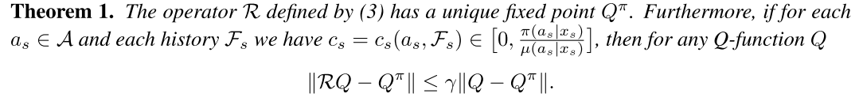
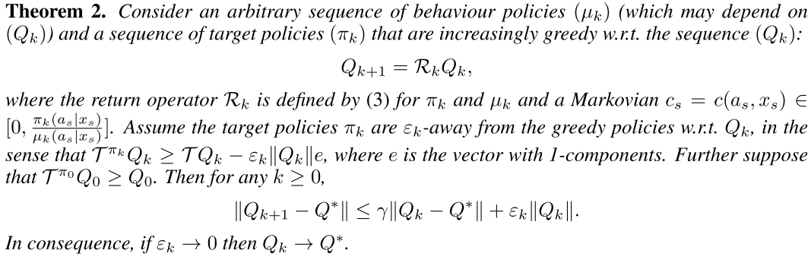
Safe and efficient off-policy reinforcement learning
2016 NIPS

Slide 23
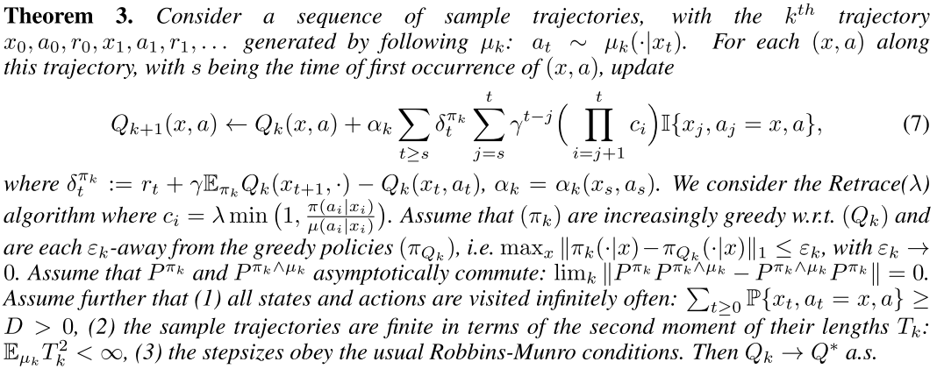
Safe and efficient off-policy reinforcement learning
2016 NIPS

Slide 24
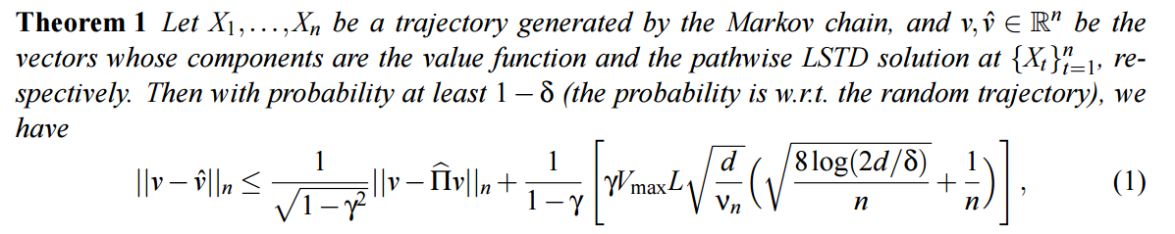
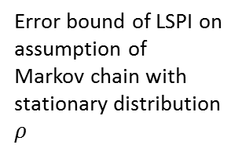
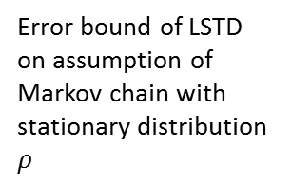
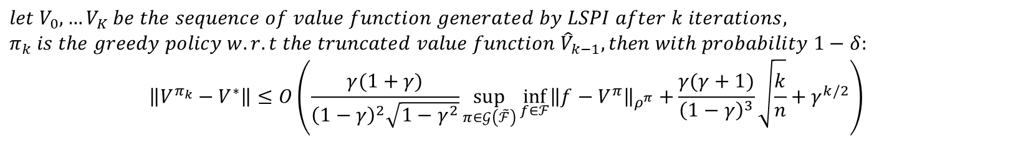
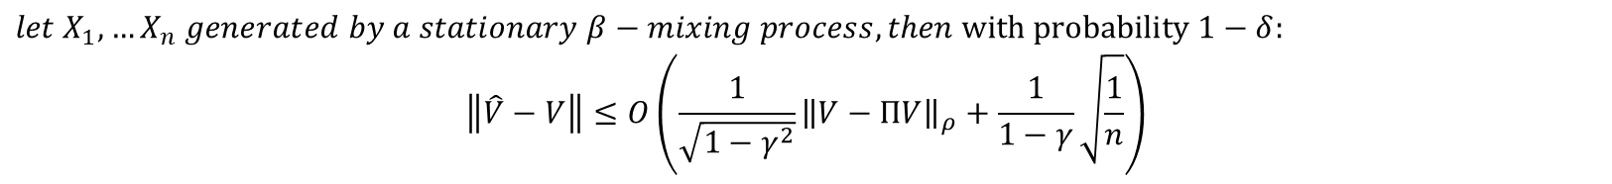
Finite-sample analysis of least-squares policy iteration
JMLR2012
the performance is evaluated only at the states visited by the Markov chain and no generalization on other states is possible
Error bound of LSTD on assumption of
Markov chain
Uniqueness of LSTD solution
$$if n>n_{0}\left(δ\right), then with probability 1−δ:$$
$$the family of features is linearly independent and the smallest eigenvalue of Φ^{T}Φ>0$$
Error bound of LSTD on assumption of
Markov chain with stationary distribution $ρ$
$$let X_{1},…X_{n} generated by a stationary β−mixing process, then with probability 1−δ:$$
$$\left\|\hat{V}−V\right\|≤O\left(\frac{1}{\sqrt{1−γ^{2}}}{\left\|V−ΠV\right\|}_{ρ}+\frac{1}{1−γ}\sqrt{\frac{1}{n}}\right)$$
$$let V_{0},…V_{K} be the sequence of value function generated by LSPI after k iterations,$$
$$π_{k} is the greedy policy w.r.t the truncated value function {\hat{V}}_{k−1}, then with probability 1−δ:$$
$$\left\|V^{π_{k}}−V^{∗}\right\|≤O\left(\frac{γ(1+γ)}{{\left(1−γ\right)}^{2}\sqrt{1−γ^{2}}}\sup_{π∈𝒢\left(\tilde{ℱ}\right)}{\inf_{f∈ℱ}{{\left\|f−V^{π}\right\|}_{ρ^{π}}+}}\frac{γ(γ+1)}{{\left(1−γ\right)}^{3}}\sqrt{\frac{k}{n}}+γ^{k/2}\right)$$
Error bound of LSPI on assumption of
Markov chain with stationary distribution $ρ$
Farahmand, Amir-massoud, Csaba Szepesvári, and Rémi Munos. "Error propagation for approximate policy and value iteration." Advances in Neural Information Processing Systems. 2010.

Slide 25
Last week discussion problem
Off policy and importance sampling

Slide 26
Paper relate to importance sampling
Importance sampling
Weighted importance sampling
Table
Off policy temporal difference learning with function approximation(2001 ICML)
Function approximation
LS
Weighted importance sampling for off policy learning with linear function approximation (2014 NIPS)
O(n)
Off policy learning based on weighted importance sampling with linear computational complexity(2015 UAL)
No importance sampling
Table
(Tree backup) Eligibility Traces for Off-Policy Policy Evaluation(2000 ICML)
Q(\lambda) with off policy corrections(2016 International Conference on Algorithmic Learning Theory)
Function approximation
Multi-step off-policy learning without importance sampling ratios(2017 arxiv)

Slide 27
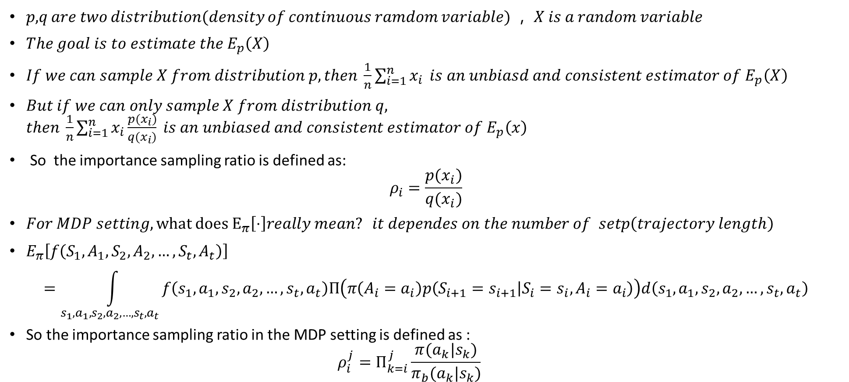
Importance sampling
𝑝,𝑞 𝑎𝑟𝑒 𝑡𝑤𝑜 𝑑𝑖𝑠𝑡𝑟𝑖𝑏𝑢𝑡𝑖𝑜𝑛(𝑑𝑒𝑛𝑠𝑖𝑡𝑦 𝑜𝑓 𝑐𝑜𝑛𝑡𝑖𝑛𝑢𝑜𝑢𝑠 𝑟𝑎𝑚𝑑𝑜𝑚 𝑣𝑎𝑟𝑖𝑎𝑏𝑙𝑒) ， 𝑋 𝑖𝑠 𝑎 𝑟𝑎𝑛𝑑𝑜𝑚 𝑣𝑎𝑟𝑖𝑎𝑏𝑙𝑒
$The goal is to estimate the E_{p}\left(X\right)$
$If we can sample X from distribution p, then \frac{1}{n}\sum_{i=1}^{n}{x_{i}} is an unbiasd and consistent estimator of E_{p}\left(X\right)$
$But if we can only sample X from distribution q, then \frac{1}{n}\sum_{i=1}^{n}{x_{i}\frac{p(x_{i})}{q(x_{i})} is an unbiased and consistent estimator of E_{p}\left(x\right)}$
So the importance sampling ratio is defined as:
$$ρ_{i}=\frac{p(x_{i})}{q(x_{i})}$$
$For MDP setting, what does E_{π}\left[⋅\right]really mean? it dependes on the number of setp\left(trajectory length\right)$
$E_{π}\left[f\left(S_{1},A_{1},S_{2},A_{2},…,S_{t},A_{t}\right)\right]$
$$=\int_{s_{1},a_{1},s_{2},a_{2},…,s_{t},a_{t}}{f\left(s_{1},a_{1},s_{2},a_{2},…,s_{t},a_{t}\right)Π\left(π\left(A_{i}=a_{i}\right)p\left(S_{i+1}=s_{i+1} | S_{i}=s_{i},A_{i}=a_{i}\right)\right)d\left(s_{1},a_{1},s_{2},a_{2},…,s_{t},a_{t}\right)}$$
So the importance sampling ratio in the MDP setting is defined as :
  $$ρ_{i}^{j}=Π_{k=i}^{j}\frac{π(a_{k}|s_{k})}{π_{b}(a_{k}|s_{k})}$$

Slide 28
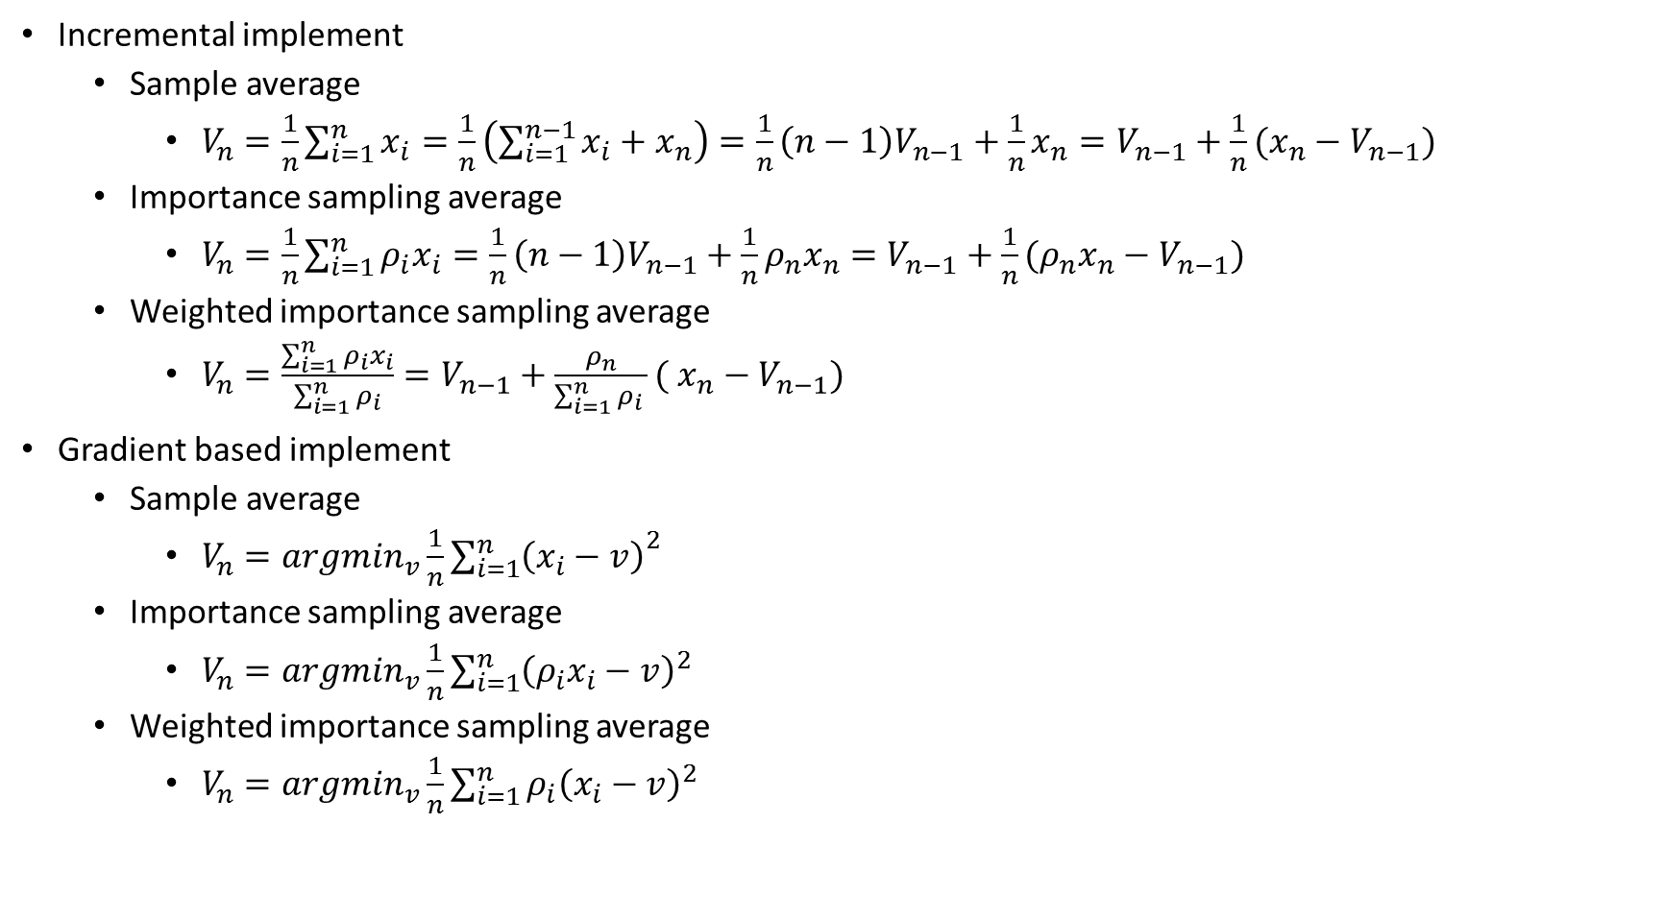
Importance sampling
Incremental implement
  Sample average
    $V_{n}=\frac{1}{n}\sum_{i=1}^{n}{x_{i}}=\frac{1}{n}\left(\sum_{i=1}^{n−1}{x_{i}}+x_{n}\right)=\frac{1}{n}\left(n−1\right)V_{n−1}+\frac{1}{n}x_{n}=V_{n−1}+\frac{1}{n}(x_{n}−V_{n−1})$
  Importance sampling average
    $V_{n}=\frac{1}{n}\sum_{i=1}^{n}{ρ_{i}x_{i}}=\frac{1}{n}\left(n−1\right)V_{n−1}+\frac{1}{n}{ρ_{n}x}_{n}=V_{n−1}+\frac{1}{n}(ρ_{n}x_{n}−V_{n−1})$
  Weighted importance sampling average
    $V_{n}=\frac{\sum_{i=1}^{n}{ρ_{i}x_{i}}}{\sum_{i=1}^{n}{ρ_{i}}}=V_{n−1}+\frac{ρ_{n}}{\sum_{i=1}^{n}{ρ_{i} }}( x_{n}−V_{n−1})$
Gradient based implement
  Sample average
    $V_{n}=argmin_{v}\frac{1}{n}{\sum_{i=1}^{n}{\left(x_{i}−v\right)}}^{2}$
  Importance sampling average
    $V_{n}=argmin_{v}\frac{1}{n}\sum_{i=1}^{n}{{\left(ρ_{i}x_{i}−v\right)}^{2}}$
  Weighted importance sampling average
    $V_{n}=argmin_{v}\frac{1}{n}\sum_{i=1}^{n}{{ρ_{i}\left(x_{i}−v\right)}^{2}}$

Slide 29
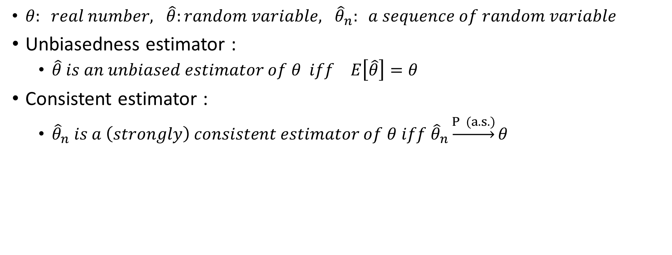
Unbiasedness and consistency analysis
$θ: real number, \hat{θ}:random variable, {\hat{θ}}_{n}: a sequence of random variable$
Unbiasedness estimator :
  $\hat{θ} is an unbiased estimator of θ iff E\left[\hat{θ}\right]=θ$
  Consistent estimator :
    ${\hat{θ}}_{n} is a \left(strongly\right) consistent estimator of θ iff {\hat{θ}}_{n}\underset{→}{P (a.s.)}θ$

Slide 30

Some useful theorem
Almost sure convergence
  $p\left(\lim_{n→∞}{x_{n}=x}\right)=1$
Converge in probability
  $\lim_{n→∞}{p\left(\left|x_{n}−x\right|>ε\right)=0}$
  Khintchine strong law of large number
    ${\left\{x_{i}\right\}}_{i=1}^{∞} iid, \frac{1}{n}\sum_{i=1}^{n}{x_{i}}→E\left(x_{1}\right) a.s.$
  Kolmogorov strong law of large numbers
    ${\left\{x_{i}\right\}}_{i=1}^{∞} independent, bound variance and same mean, \frac{1}{n}\sum_{i=1}^{n}{x_{i}}→E\left(x_{1}\right) a.s.$
  Weak law of large numbers
    ${\left\{x_{i}\right\}}_{i=1}^{∞} iid, E\left(\left|x_{i}\right|\right)<∞, \frac{1}{n}\sum_{i=1}^{n}{x_{i}}→E\left(x_{1}\right) in probability$

Slide 31

Importance sampling
$V_{n}=\frac{1}{n}\sum_{i=1}^{n}{ρ_{i}x_{i}}$
Unbiased
  $E_{q}\left[\frac{1}{n}\sum_{i=1}^{n}{ρ_{i}x_{i}}\right]=E_{p}[\frac{1}{n}\sum_{i=1}^{n}{x_{i}}]=\frac{1}{n}\sum_{i=1}^{n}{E_{p}\left[x_{i}\right]}=E_{p}[x_{i}]$
Consistent
  $x_{i} IID$ + ${ V}_{n}$unbiased for $∀ n$ -> $V_{n}$ convergence a.s. to $E_{p}(x_{i})$

Slide 32

Weighted importance sampling
$V_{n}=\frac{\sum_{i=1}^{n}{ρ_{i}x_{i}}}{\sum_{i=1}^{n}{ρ_{i}}}=\frac{\frac{1}{n}\sum_{i=1}^{n}{ρ_{i}x_{i}}}{\frac{1}{n}\sum_{i=1}^{n}{ρ_{i}}}$
Biased
Consistent
  $\frac{1}{n}\sum_{i=1}^{n}{ρ_{i}}→1 a.s.$(i.i.d + $E_{q}\left(ρ_{i}\right)=1$)
  $\frac{1}{n}\sum_{i=1}^{n}{ρ_{i}x_{i}}→E_{p}\left(x_{i}\right) a.s.$ (consistency of IS)
    So that $V_{n}$ convergence a.s. to $E_{p}(x_{i})$
Variance analysis
  $var(V_{n})→0$
    Proof $:say \left|e_{N}\right|≤C$
    $var\left(V_{n}\right)=E{[\left(V_{n}−μ\right)}^{2}]=\int_{\left|V_{n}−μ\right|<ε}{{\left(V_{n}−μ\right)}^{2}dq}+\int_{\left|V_{n}−μ\right|>ε}{{\left(V_{n}−μ\right)}^{2}dq}≤ε^{2}+{4C}^{2}P(\left|V_{n}−μ\right|>ε)$

Slide 33
summary
Eligibility trace
Convergence rate analysis
Off policy and importance sampling

Slide 34
Thanks

Slide 35
RL algorithms analysis
Yue Wang
2017.3.8

Slide 36
Content
Basic notation
Evaluation problem
  Objective function
  Optimization techniques
  Extend to off-policy and eligibility trace
  Paper
  Control problem
    relationship and difference between control and evaluation problem
    paper

Slide 37

Basic notation
Discounted Markov decision process(MDP) : $\left(𝒳,𝒜,r,p,γ\right)$
  r : $𝒳×𝒜×𝒳 → ℝ$
  $p\left(. | x,a\right)is a distribution over𝒳$
  $γ∈\left(0,1\right)$
$π :𝒳×𝒜→(0,1)$
State-value function $V^{π}$
  $V^{π}\left(x\right)=E_{p,π}[\sum_{t=0}^{∞}{γ^{t}r_{t}|x_{0}=x}]$
Action-value function $Q^{π}$
  $Q^{π}\left(x,a\right)=E_{p,π}\left[\sum_{t=0}^{∞}{γ^{t}r_{t}|x_{0}=x,a_{0}=a }\right]$
Bellman operator :
  $T^{π}V\left(x\right)=\iint_{a,x′}{r\left(x,a,x′\right)π\left(a | x\right)p\left(x^{′} | x,a\right)dadx′}+γ\iint_{a,x′}{V(x′)π\left(a | x\right)p\left(x^{′} | x,a\right)dadx′}$
  Function approximation
    $V\left(s\right)≈V_{θ}\left(s\right)=θ^{T}φ\left(s\right) φ :𝒳→ℝ^{d}$
  Simplify notation
    $V as a \left|𝒳\right|dimsnsion verctor R as a\left|𝒳\right|dimsnsion verctor with R_{i}=E_{p,π}(r(x_{i}))$
    $Φ as a\left|𝒳\right|×d dimsnsion verctor, each row repersent a state$

Slide 38


Two class of problems
Evaluation problem
  Behavior policy $(π_{b})$ (data generated from)
  Target policy $(π)$ （to evaluate）
Control problem
  Sequence of policy $π_{b}^{k} π^{k}$
  Sequence of value function $V_{π_{k}}$
  Seek an optimal policy $π^{∗}$
On policy : $π_{b}=π$
Off policy : $π_{b}≠π$

Slide 39
Evaluation problem
Algorithms for evaluation :
  Objection function + optimization techniques

Slide 40

Objective function
  $δ=r_{t}+{\left(γϕ_{t+1 }−ϕ_{t}\right)}^{T}θ$
  $ϕ_{t}=ϕ(s_{t})$ $D=diag[d^{π}\left(s_{1}\right),…]$
  $MSE\left(θ\right)={\left\|V_{θ}−V^{π}\right\|}_{D}^{2}=\sum_{i=1}^{m}{d^{π}\left(s_{i}\right){\left[V_{θ}\left(s_{i}\right)−V^{π}\left(s_{i}\right)\right]}^{2}=E_{d}\left[{\left[V_{θ}\left(s\right)−V^{π}\left(s\right)\right]}^{2} | s_{i}=s_{i}\right]}$
    Monte-Carlo
  $MSBE\left(θ\right)={\left\|V_{θ}−{TV}_{θ}\right\|}_{D}^{2}=E_{d}\left[E_{p,π}{\left[δ | s_{t}\right]}^{2}\right]=E_{d}\left[{\left({\left(E_{p,π}\left[γφ_{t+1} | s_{t}\right]−φ_{t}\right)}^{T}θ+E_{p,π}\left[r_{t} | s_{t}\right]\right)}^{2}\right]$
    Double sampling
  $MSTDE\left(θ\right)=E_{d}\left[E_{p,π}\left[δ^{2} | s_{t}\right]\right]=E_{d,p,π}\left[δ^{2}\right]$
    Residual TD learning
  $MSPBE\left(θ\right)={\left\|V_{θ}−{ΠTV}_{θ}\right\|}_{D}^{2}={\left\|V_{θ}−{TV}_{θ}\right\|}_{DΦ{\left(Φ^{T}DΦ\right)}^{−1}Φ^{T}D}^{2}=E_{d,π,p}{\left[φ_{t}δ_{t}\right]}^{T}E_{d}\left[φ_{t}φ_{t}^{T}\right]E_{d,π,p}\left[φ_{t}δ_{t}\right]={\left\|Φ^{T}D(V_{θ}−{TV}_{θ})\right\|}_{{\left(Φ^{T}DΦ\right)}^{−1}}^{2}$
    LSTD, GTD2, TDC
  $NEU\left(θ\right)={\left\|{Φ^{T}D(V}_{θ}−{TV}_{θ})\right\|}_{2}^{2}=E_{d,p,π}{\left[δφ\right]}^{T}E_{d,p,π}\left[δφ\right]$
    GTD
  OPE-FPE
  $$θ={argmin}_{θ^{′}}OPE\left(θ^{′},w\right)={argmin}_{θ^{′}}\left\|V_{θ^{′}}−{TV}_{w}\right\|$$
  $$w=argmin_{w^{′}}FPE\left(θ,w′\right)={argmin}_{w′}\left\|V_{θ}−{TV}_{w′}\right\|$$
    TD learning

Slide 41




Objective function
$$MSE\left(θ\right)≤\frac{C\left(d\right)}{1−γ}MSBE\left(θ\right) ,C\left(d\right)=\max_{x_{i},x_{j}}(\frac{\sum_{a}{P\left(x_{j} | x_{i},a\right)π(a|x_{i})}}{d^{π}(x_{i})}$$
$$MSBE\left(θ\right)=MSPBE\left(θ\right)+{\left\|TV_{θ}−ΠTV_{θ}\right\|}_{D}^{2}$$
$MSTDE\left(θ\right)−MSBE\left(θ\right)=E_{d}\left[E_{p,π}\left[δ^{2} | s_{t}\right]−E_{p,π}{\left[δ | s_{t}\right]}^{2}\right]=E_{d}[var(δ^{2}|s_{t})]$

Slide 42



optimization techniques
    $MSPBE\left(θ\right)={\left\|V_{θ}−{ΠTV}_{θ}\right\|}_{D}^{2}$ $={\left\|Φ^{T}D(V_{θ}−{TV}_{θ})\right\|}_{{\left(Φ^{T}DΦ\right)}^{−1}}^{2}=‖Φ^{T}D \left(Φθ −γPΦθ−R\right){\left.​\right\|}_{M}={\left\|Φ^{T}D \left(Φ −γPΦ)θ−Φ^{T}DR\right)\right\|}_{M}$
$$=E_{d,π,p}{\left[φ_{t}δ_{t}\right]}^{T}E_{d}{\left[φ_{t}φ_{t}^{T}\right]}^{−1}E_{d,π,p}\left[φ_{t}δ_{t}\right]$$
$=E_{d,π,p}{\left[r_{t}φ_{t}−{φ_{t}\left(γφ_{t+1}−φ_{t}\right)}^{T}θ\right]}^{T}E_{d}{\left[φ_{t}φ_{t}^{T}\right]}^{−1}E_{d,π,p}\left[r_{t}φ_{t}−{φ\left(γφ_{t+1}−φ_{t}\right)}^{T}θ\right]$
$=E_{d,π,p}{\left[b−Aθ\right]}^{T}E_{d}{\left[φ_{t}φ_{t}^{T}\right]}^{−1}E_{d,π,p}\left[b−Aθ\right]$
Gradient based
  Semi-gradient based
    OPE-FPE
    $θ={argmin}_{θ^{′}}OPE\left(θ^{′},w\right)={argmin}_{θ^{′}}\left\|V_{θ^{′}}−{TV}_{w}\right\|$
    $w=argmin_{w^{′}}FPE\left(θ,w′\right)={argmin}_{w′}\left\|V_{θ}−{TV}_{w′}\right\|$
  True-gradient based
    $θ_{t+1 }=θ_{t}+α\frac{d(MSPBE(θ))}{d(θ)}$
Least square based
    $θ=({A^{T}MA)}^{−1}A^{T}Mb={\left(Φ^{T}D\left(Φ−γPΦ\right)\right)}^{−1}Φ^{T}DR=A^{−1}b$
    $A=\left(Φ^{T}D(Φ−γPΦ)\right) → A_{t+1}=A_{t}+φ_{t}{\left(φ_{t}−γφ_{t+1}\right)}^{T}$
    $b=Φ^{T}DR → b_{t+1}=b_{t}+φ_{t}r_{t}$
$${\left(A_{t}+uv^{T}\right)}^{−1}=A_{t}^{−1}−\frac{A_{t}^{−1}uv^{T}A_{t}^{−1}}{1+v^{T}A_{t}^{−1}u}$$

Slide 43


Off policy
On policy : $π_{b}=π$
Off policy : $π_{b}≠π$
$ρ_{k}=\frac{μ(a_{k}|s_{k})}{π(a_{k}|s_{k})}$
Importance sampling(most used)
  $\tilde{v}=\frac{\sum_{k=1}^{n}{ρ_{k}v_{k}}}{n}$
Weighted importance sampling
  $\hat{v}=\frac{\sum_{k=1}^{n}{ρ_{k}v_{k}}}{\sum_{k=1}^{n}{ρ_{k}}}$
Mahmood, A. Rupam, Hado P. van Hasselt, and Richard S. Sutton. "Weighted importance sampling for off-policy learning with linear function approximation." Advances in Neural Information Processing Systems. 2014.
Mahmood, Ashique Rupam, and Richard S. Sutton. "Off-policy learning based on weighted importance sampling with linear computational complexity." UAI. 2015.

Slide 44

Off-policy TD learning
OPE-FPE
$θ_{t+1 }=θ_{t}+α_{t}ρ_{t}δ_{t}{φ(s}_{t})=θ_{t}+α_{t}(\underset{b_{t}}{\underbrace{ρ_{t}R_{t}φ_{t}}}− \underset{A_{t}}{\underbrace{ρ_{t}φ_{t}{\left(φ_{t}−γφ_{t+1}\right)}^{T}}}θ_{t})$
$ρ_{t}=\frac{π_{G\left(a_{t} | s_{t}\right)}}{π_{B\left(a_{t} | s_{t}\right)}}$
                ·
Stochastic algorithm is stable
Corresponding deterministic algorithms converge
A matrix has a full set of eigenvalues and real parts are positive
stochastic algorithm is stable + learning rate$α$is reduce according to an appropriate schedule
Convergence almost sure
Schoknecht, Ralf. "Optimality of reinforcement learning algorithms with linear function approximation." NIPS. Vol. 15. 2002.

Slide 45

Off-policy LSTD
    On-policy :
    $θ=({A^{T}MA)}^{−1}A^{T}Mb={\left(Φ^{T}D\left(Φ−γPΦ\right)\right)}^{−1}Φ^{T}DR=A^{−1}b$
    $A=\left(Φ^{T}D(Φ−γPΦ)\right) → A_{t+1}=A_{t}+φ_{t}{\left(φ_{t}−γφ_{t+1}\right)}^{T}$
    $b=Φ^{T}DR →b_{t+1}=b_{t}+φ_{t}r_{t}$
    Off-policy :
    $A_{t+1}=A_{t}+φ_{t}{\left(φ_{t}−γρ_{t}φ_{t+1}\right)}^{T}$
    $b_{t+1}=b_{t}+φ_{t}ρ_{t}r_{t}$

Slide 46


eligibility traces
$$∀V∈ℝ^{s}, T^{λ}V=\left(1−λ\right)\sum_{k=0}^{∞}{λ^{k}T^{k+1}V}$$
$$T^{λ}V=V+{\left(I−λγP\right)}^{−1 }(R+γPV−V)$$
$G_{t}^{λ}=\left(1−λ\right)\sum_{n=1}^{T−t−1}{λ^{n−1}G_{t}^{(n)}}+λ^{T−t−1}G_{t}$
$θ_{t+1 }=θ_{t}+α\left[G_{t}^{λ}−\hat{v}\left(s_{t},θ_{t}\right)\right]∇\hat{v}(s_{t},θ_{t})$
$G_{t}^{(n)}=R_{t+1}+γR_{t+2}+γ^{2}R_{t+3}+…+γ^{n−1}R_{t+n}+γ^{n}\hat{v}(s_{t+n},θ_{t})$
$e_{t}=∇\hat{v}\left(s_{t},θ_{t}\right)+γλe_{t−1} e_{0}=0$
$δ_{t}=R_{t+1 }+γ\hat{v}\left(s_{t+1},θ_{t}\right)−\hat{v}(s_{t},θ_{t})$
$θ_{t+1}=θ_{t}+αδ_{t}e_{t}$

Slide 47
Off policy with eligibility traces(TD($λ$))

Slide 48
Off policy with eligibility traces(LSTD($λ$))
Without eligibility trace
With eligibility trace
    $$A_{j}=\sum_{j=1}^{i}{φ_{j}{\left(φ_{j}−γρ_{j}φ_{j+1}\right)}^{T}}$$
    $$b_{i}=\sum_{j=1}^{i}{φ_{j}ρ_{j}r_{j}}$$

Slide 49
Off-Policy
 | Proposed | Convergence | Convergence rate
LSTD(0) | Bradtke S J, Barto A G. Linear least-squares algorithms for temporal difference learning[J]. Machine learning, 1996, 22(1-3): 33-57. | As below
LSTD($λ$) | Bertsekas D P, Yu H. Projected equation methods for approximate solution of large linear systems[J]. Journal of Computational and Applied Mathematics, 2009, 227(1): 27-50. | Yu H. Convergence of least squares temporal difference methods under general conditions[C]//Proceedings of the 27th International Conference on Machine Learning (ICML-10). 2010: 1207-1214. | no
GTD(0) | Sutton R S, Maei H R, Szepesvári C. A Convergent $ O (n) $ Temporal-difference Algorithm for Off-policy Learning with Linear Function Approximation[C]//Advances in neural information processing systems. 2009: 1609-1616. | As left | Liu B, Liu J, Ghavamzadeh M, et al. Finite-Sample Analysis of Proximal Gradient TD Algorithms[C]//UAI. 2015: 504-513.
GTD2(0) | Sutton R S, Maei H R, Precup D, et al. Fast gradient-descent methods for temporal-difference learning with linear function approximation[C]//Proceedings of the 26th Annual International Conference on Machine Learning. ACM, 2009: 993-1000. | As left | As above
GQ($λ$) | Maei H R, Sutton R S. GQ (λ): A general gradient algorithm for temporal-difference prediction learning with eligibility traces[C]//Proceedings of the Third Conference on Artificial General Intelligence. 2010, 1: 91-96. | As left | Not find
ETD | Sutton R S, Mahmood A R, White M. An emphatic approach to the problem of off-policy temporal-difference learning[J]. The Journal of Machine Learning Research, 2015, 17: 1-29. | As left Yu H. On Convergence of Emphatic Temporal-Difference Learning[C]//COLT. 2015: 1724-1751. | no
ELSTD | Yu H. On Convergence of Emphatic Temporal-Difference Learning[C]//COLT. 2015: 1724-1751. | Yu H. On Convergence of Emphatic Temporal-Difference Learning[C]//COLT. 2015: 1724-1751. | no
ATD | Pan Y, White A, White M. Accelerated Gradient Temporal Difference Learning[J]. arXiv preprint arXiv:1611.09328, 2016. | As left | As left

Slide 50

On-Policy
 | Propose | Convergence | Convergence rate
TD(0) | Sutton R S. Learning to predict by the methods of temporal differences[J]. Machine learning, 1988, 3(1): 9-44. | As left | As below
TD($λ$) | As above | Tsitsiklis J N, Van Roy B. An analysis of temporal-difference learning with function approximation[J]. IEEE transactions on automatic control, 1997, 42(5): 674-690. | Actor-Critic Algorithms?
LSTD(0) | Bradtke S J, Barto A G. Linear least-squares algorithms for temporal difference learning[J]. Machine learning, 1996, 22(1-3): 33-57. | As below | Lazaric A, Ghavamzadeh M, Munos R. Finite-sample analysis of LSTD[C]//ICML-27th International Conference on Machine Learning. 2010: 615-622. Lazaric A, Ghavamzadeh M, Munos R. Finite-sample analysis of least-squares policy iteration[J]. Journal of Machine Learning Research, 2012, 13(Oct): 3041-3074.
LSTD($λ$) | Boyan J A. Technical update: Least-squares temporal difference learning[J]. Machine Learning, 2002, 49(2-3): 233-246. Boyan J A. Least-squares temporal difference learning[C]//ICML. 1999: 49-56. | Nedić A, Bertsekas D P. Least squares policy evaluation algorithms with linear function approximation[J]. Discrete Event Dynamic Systems, 2003, 13(1): 79-110. | Tagorti M, Scherrer B. On the Rate of Convergence and Error Bounds for LSTD (λ)[C]//ICML. 2015: 1521-1529.

Slide 51
On the rate of convergence and error bounds for LSTD($λ$)
2015 ICML
On-policy, policy evolution, LSTD($λ$)
Theorem :

Slide 52

On the rate of convergence and error bounds for LSTD($λ$)
2015 ICML
On-policy, policy evolution, LSTD($λ$)
Future work:
  Extend to policy iteration scheme
  LSTD($λ$) for off-policy

Slide 53
Finite-Sample Analysis of Proximal Gradient TD Algorithms
2015 UAL
On/Off-policy, policy evolution, GTD

Slide 54

Objective function
  $δ=r_{t}+{\left(γϕ_{t+1 }−ϕ_{t}\right)}^{T}θ$
  $ϕ_{t}=ϕ(s_{t})$ $D=diag[d^{π}\left(s_{1}\right),…]$
  $MSE\left(θ\right)={\left\|V_{θ}−V^{π}\right\|}_{D}^{2}=\sum_{i=1}^{m}{d^{π}\left(s_{i}\right){\left[V_{θ}\left(s_{i}\right)−V^{π}\left(s_{i}\right)\right]}^{2}=E_{d}\left[{\left[V_{θ}\left(s\right)−V^{π}\left(s\right)\right]}^{2} | s_{i}=s_{i}\right]}$
    Monte-Carlo
  $MSBE\left(θ\right)={\left\|V_{θ}−{TV}_{θ}\right\|}_{D}^{2}=E_{d}\left[E_{p,π}{\left[δ | s_{t}\right]}^{2}\right]=E_{d}\left[{\left({\left(E_{p,π}\left[γφ_{t+1} | s_{t}\right]−φ_{t}\right)}^{T}θ+E_{p,π}\left[r_{t} | s_{t}\right]\right)}^{2}\right]$
    Double sampling
  $MSTDE\left(θ\right)=E_{d}\left[E_{p,π}\left[δ^{2} | s_{t}\right]\right]=E_{d,p,π}\left[δ^{2}\right]$
    Residual TD learning
  $MSPBE\left(θ\right)={\left\|V_{θ}−{ΠTV}_{θ}\right\|}_{D}^{2}={\left\|V_{θ}−{TV}_{θ}\right\|}_{DΦ{\left(Φ^{T}DΦ\right)}^{−1}Φ^{T}D}^{2}=E_{d,π,p}{\left[φ_{t}δ_{t}\right]}^{T}E_{d}\left[φ_{t}φ_{t}^{T}\right]E_{d,π,p}\left[φ_{t}δ_{t}\right]={\left\|Φ^{T}D(V_{θ}−{TV}_{θ})\right\|}_{{\left(Φ^{T}DΦ\right)}^{−1}}^{2}$
    LSTD, GTD2, TDC
  $NEU\left(θ\right)={\left\|{Φ^{T}D(V}_{θ}−{TV}_{θ})\right\|}_{2}^{2}=E_{d,p,π}{\left[δφ\right]}^{T}E_{d,p,π}\left[δφ\right]$
    GTD
  OPE-FPE
  $$θ={argmin}_{θ^{′}}OPE\left(θ^{′},w\right)={argmin}_{θ^{′}}\left\|V_{θ^{′}}−{TV}_{w}\right\|$$
  $$w=argmin_{w^{′}}FPE\left(θ,w′\right)={argmin}_{w′}\left\|V_{θ}−{TV}_{w′}\right\|$$
    TD learning

Slide 55
Finite-Sample Analysis of Proximal Gradient TD Algorithms
  $MSPBE\left(θ\right)={\left\|V_{θ}−{ΠTV}_{θ}\right\|}_{D}^{2}={\left\|V_{θ}−{TV}_{θ}\right\|}_{DΦ{\left(Φ^{T}DΦ\right)}^{−1}Φ^{T}D}^{2}=E_{d,π,p}{\left[φ_{t}δ_{t}\right]}^{T}E_{d}\left[φ_{t}φ_{t}^{T}\right]E_{d,π,p}\left[φ_{t}δ_{t}\right]={\left\|Φ^{T}D(V_{θ}−{TV}_{θ})\right\|}_{{\left(Φ^{T}DΦ\right)}^{−1}}^{2}$
    LSTD, GTD2, TDC
  $NEU\left(θ\right)={\left\|{Φ^{T}D(V}_{θ}−{TV}_{θ})\right\|}_{2}^{2}=E_{d,p,π}{\left[δφ\right]}^{T}E_{d,p,π}\left[δφ\right]$
    GTD
$J\left(θ\right)={\left\|Φ^{T}D\left(V_{θ}−TV_{θ}\right)\right\|}_{M^{−1}}^{2}={\left\|E[ρ_{t}δ_{t}φ_{t}]\right\|}_{M^{−1}}^{2} M=I for GTD M=Φ^{T}DΦ for GTD2$

Slide 56
An emphatic approach to the problem of off-policy temporal-difference learning
2016 JMLR
Off-policy, policy evolution,
Future work:
  Extend to control setting
  Extend to weighted importance sampling
  Extend to action-value function

Slide 57
Generalized Emphatic Temporal Difference Learning: Bias-Variance Analysis
2016 AAAI
Off-policy, policy evolution, ETD
ETD$\left(0,β\right)$: $θ_{t+1}=θ_{t}+αF_{t}ρ_{t}\left(r_{t+1}+γθ_{t}^{T}φ_{t+1}−θ_{t}^{T}φ_{t}\right)φ_{t}$
$F_{t}=βρ_{t−1}F_{t−1}+1$
Define : $f=d_{μ}+βP_{π}^{T}d_{μ}+{\left(βP_{π}^{T}\right)}^{2}d_{μ}+…={\left(I−βP_{π}^{T}\right)}^{−1}d_{μ}$ $κ=\min_{s}\frac{d_{μ}(s)}{f(s)} ∈\left[0,1−β\right]$
$⁡$
Bias analysis:

Slide 58
Generalized Emphatic Temporal Difference Learning: Bias-Variance Analysis
2016 AAAI
Off-policy, policy evolution, ETD
ETD$\left(0,β\right)$: $θ_{t+1}=θ_{t}+αF_{t}ρ_{t}\left(r_{t+1}+γθ_{t}^{T}φ_{t+1}−θ_{t}^{T}φ_{t}\right)φ_{t}$
$F_{t}=βρ_{t−1}F_{t−1}+1$
Define : $f=d_{μ}+βP_{π}^{T}d_{μ}+{\left(βP_{π}^{T}\right)}^{2}d_{μ}+…={\left(I−βP_{π}^{T}\right)}^{−1}d_{μ}$ $κ=\min_{s}\frac{d_{μ}(s)}{f(s)} ∈\left[0,1−β\right]$
Variance analysis :

Slide 59
Control problem
Bellman operator $T^{π}Q=r+γP^{π}Q$ fix point is $Q^{π}$
Bellman optimality operator $TQ=r+γ\max_{π}{P^{π}Q}$ fix point is $Q^{∗}$
Two ways to find fix point of bellman optimality operator:
  Policy iteration (evaluation -> improvement -> evaluation -> …)
  Value iteration(directly use bellman optimality operator)

Slide 60
Safe and efficient off-policy reinforcement learning
2016 NIPS
Off-policy, policy evolution/control,
Importance sampling : $c_{s}=\frac{π(a_{s}|x_{s})}{μ(a_{s}|x_{s})}$ suffer from large variance
Off-policy : $c_{s}=λ$ note safe（not converge for arbitrary $π and μ$）
Tree-backup : $c_{s}=λπ\left(a_{s} | x_{s}\right)$ not efficient(even on policy, unnecessarily cuts the traces)
Retrace($λ$) : $c_{s}=λ\min\left(1,\frac{π\left(a_{s} | x_{s}\right)}{μ\left(a_{s} | x_{s}\right)}\right)$ safe and efficient ($\min\left(1,\frac{π\left(a_{s} | x_{s}\right)}{μ\left(a_{s} | x_{s}\right)}\right)>π\left(a_{s} | x_{s}\right)$)

Slide 61
Safe and efficient off-policy reinforcement learning
2016 NIPS

Slide 62
Safe and efficient off-policy reinforcement learning
2016 NIPS

Slide 63


Finite-sample analysis of least-squares policy iteration
JMLR2012
the performance is evaluated only at the states visited by the Markov chain and no generalization on other states is possible
Error bound of LSTD on assumption of
Markov chain
Uniqueness of LSTD solution
$$if n>n_{0}\left(δ\right), then with probability 1−δ:$$
$$the family of features is linearly independent and the smallest eigenvalue of Φ^{T}Φ>0$$
$$let X_{1},…X_{n} generated by a stationary β−mixing process, then with probability 1−δ:$$
$$\left\|\hat{V}−V\right\|≤O\left(\frac{1}{\sqrt{1−γ^{2}}}{\left\|V−ΠV\right\|}_{ρ}+\frac{1}{1−γ}\sqrt{\frac{1}{n}}\right)$$
Error bound of LSTD on assumption of
Markov chain with stationary distribution $ρ$
$$let V_{0},…V_{K} be the sequence of value function generated by LSPI after k iterations,$$
$$π_{k} is the greedy policy w.r.t the truncated value function {\hat{V}}_{k−1}, then with probability 1−δ:$$
$$\left\|V^{π_{k}}−V^{∗}\right\|≤O\left(\frac{γ(1+γ)}{{\left(1−γ\right)}^{2}\sqrt{1−γ^{2}}}\sup_{π∈𝒢\left(\tilde{ℱ}\right)}{\inf_{f∈ℱ}{{\left\|f−V^{π}\right\|}_{ρ^{π}}+}}\frac{γ(γ+1)}{{\left(1−γ\right)}^{3}}\sqrt{\frac{k}{n}}+γ^{k/2}\right)$$
Error bound of LSPI on assumption of
Markov chain with stationary distribution $ρ$
Farahmand, Amir-massoud, Csaba Szepesvári, and Rémi Munos. "Error propagation for approximate policy and value iteration." Advances in Neural Information Processing Systems. 2010.

Slide 64
Summary
RL notation and setting
  Focus on linear function approximation and value function based algorithms.
Evaluation problem
  Objective function
  optimization techniques
  Extension to off-policy case and eligibility trace
  Analysis about algorithms’ convergence, convergence rate, bias and variance
Control problem
  Two ways to find fix point of bellman optimality operator
  Plan
    A papers list about other topic related to RL algorithms analysis in icml and nips from 2014 to 2016
    Select some of these papers for next seminar. Concentrate on story.

Slide 65
Thanks

